Slide 1
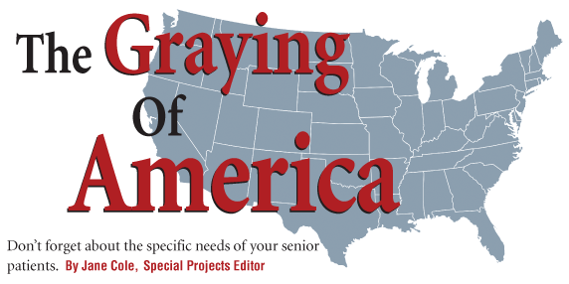
October 01, 2013
tuesday

Slide 2
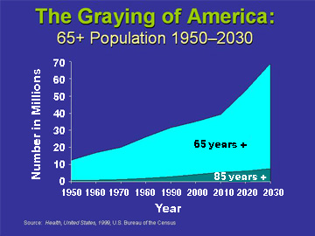
Demographics
THINK: What are the implications of a rapidly increasing elderly population?

Slide 3
Graying of America
Group Articles
In each group you will read your section of the article.
Take notes on main points of your section in your notebook.
Write any challenges to your future in your notebook.
When finished:
Take turns and discuss with your teammates what you found.
Share in order of groups (1-5)

Slide 4
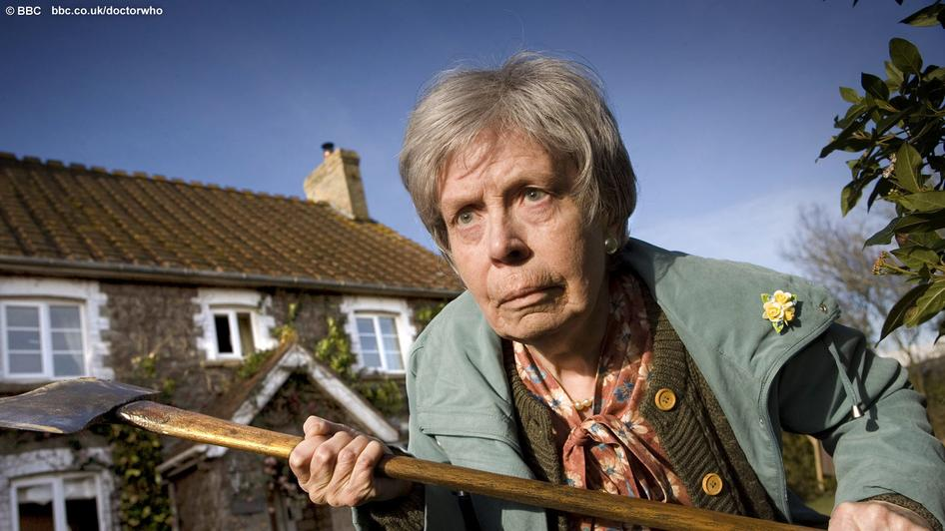
i am coming for you…

