Slide 1
Italy & Greece– Spring Break 2015

Slide 2
Are you not entertained?

Slide 3
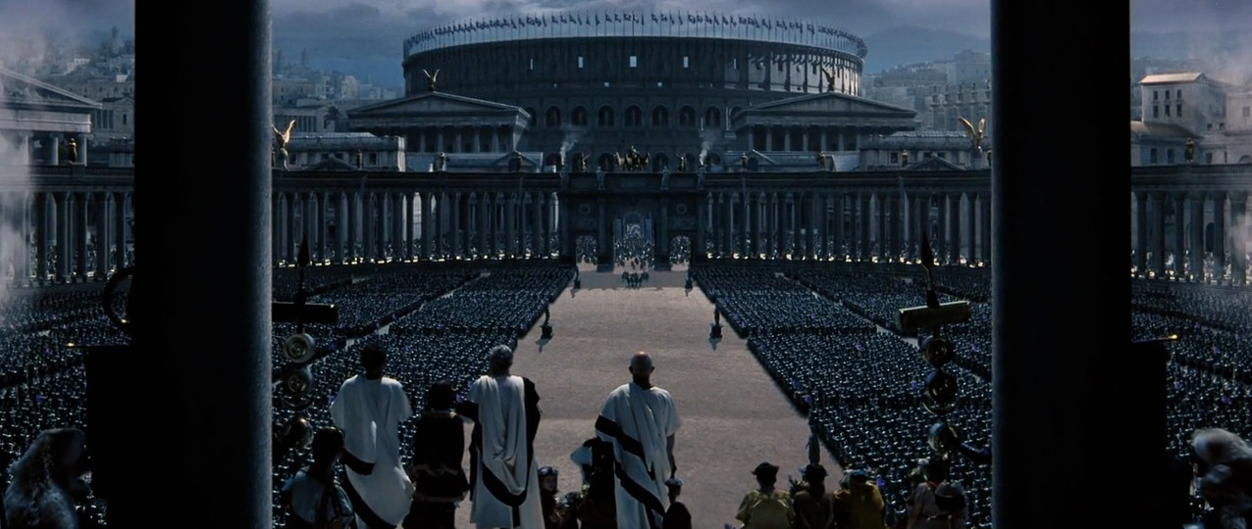
Our Entrance to Rome

Slide 4
FORREST

Slide 6
2015
1525476UW

Slide 7
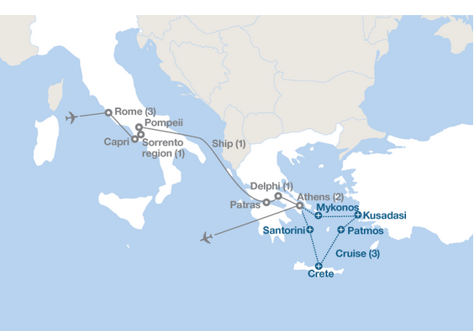
We’re going to Italy & Greece! March 14-23, 2015

Slide 8
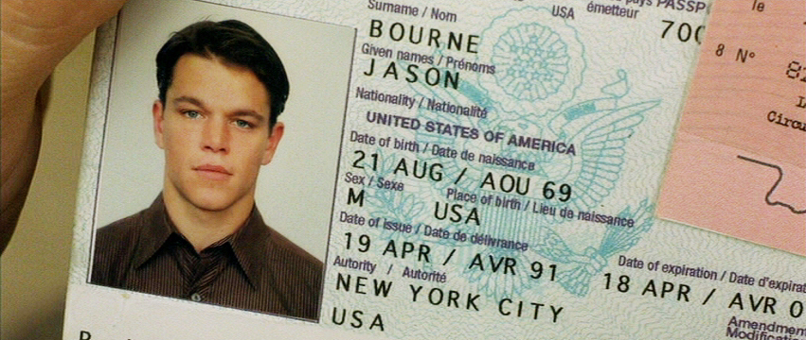
Passports?
Get at least 6 weeks before (Nov-Jan)
Smile

Slide 10
What to Pack?
TRAVEL LIGHT!
EF Tours list and Bob’s list
Carry-on VS. Check-in
Prescriptions

Slide 11
What to Buy?
Electrical converters, cell phone plans, Viber/Skype, travel sized items, rainy clothing, contacts, journal
flashlight?
alarm clock/watch?
light rain jacket?
small/light umbrella?
FLEEEEEEEEEEEEEEEEEEEEEEEEEEEEEEEEEECE

Slide 12
Weather?

Slide 14
Future Meetings
January Meeting (1/20-23)
Practice for the trip
Order money from banks (Euros)
Packing List
Meals
February Meeting (2/17-20)
Practice for the trip
Procedures (passport control, baggage customs, hotels, travelling, bus, etc.)

Slide 15
Rooming Arrangements

Slide 16
ROOMING UPGRADES?
For adults and any students wishing to Upgrade
(options 1-4). Below are the options:
1.) Standard Adult double: No additional fee
2.) Adult single upgrade: $40/night
3.) Student twin upgrade (with an adult or another student): $30/night (both students)
4.) Family room (2 adults & a student OR 2 students & an adult): no additional fee *Third bed will likely be a pull out cot

Slide 17
Fundraisers?

Slide 18
FUNraising
Get together and discuss cool ideas for getting people together to build excitement for the trip
Movies?
Gladiator?
Audrey Hepburn’s Roman Holiday?
Italian/Greek food – meals at restaurants/homes?
Other ideas about fun things to do?
Practicing Italian?

