Slide 1
FRIDAY!
October, 2015

Slide 2
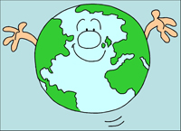
Warm Up
List what you think are the happiest 10 Countries in the world

Slide 3
World Happiness Report
10. Australia (7.284)
9. New Zealand (7.286)
8. Sweden (7.364)
7. Netherlands (7.378)
6. Finland (7.406)
5. Canada (7.427)
4. Norway (7.522)
3. Denmark (7.527)
2. Iceland (7.561)
1. Switzerland (7.587)

Slide 4
World Happiness Report
Measurement of Happiness:
GDP per capita
Social support
Healthy life expectancy
Freedom to make life choices
Generosity
Perceptions of corruption
Plirms per capita

Slide 5
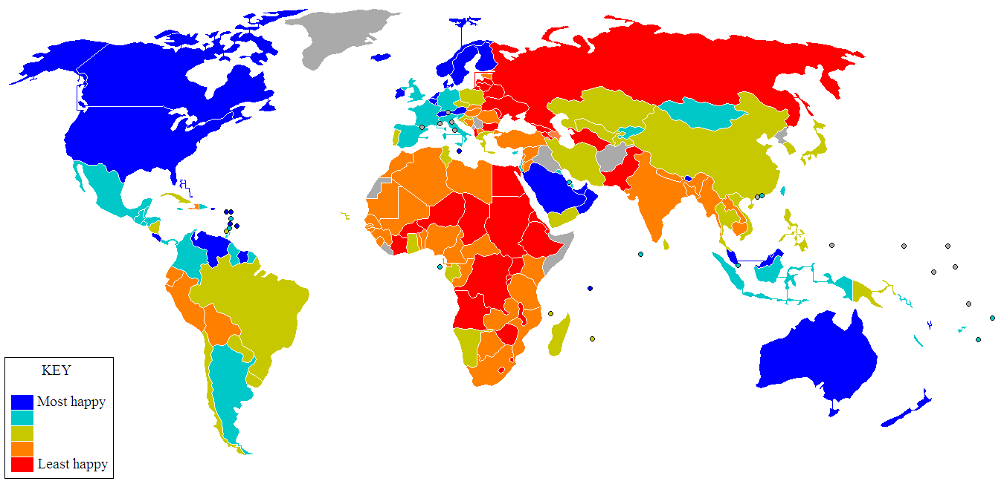
Satisfaction with Life Index

Slide 6
Happiness test
Take your own Happiness Test.
Add up your team’s scores.
Class Average?
What makes a person happy?
What makes a country a happy country?

Slide 7
Geography of Bliss
The Netherlands : happiness is a number Switzerland : happiness is boredom Bhutan : happiness is a policy Qatar : happiness is a winning lottery ticket Iceland : happiness is failure Moldova : happiness is somewhere else Thailand : happiness is not thinking Great Britain : happiness is a work in progress India : happiness is a contradiction America : happiness is home

